Slide 1
C++ functions 1
Fun!

Slide 2
function
A function is a body of code that returns a value
The value returned may depend on arguments provided to the function
Functions "Encapsulate" a task (they combine many instructions into a single line of code)

Slide 3
Why do we write functions?
They allow us to conceive of our program as a bunch of sub-steps
Each sub-step can be its own function. When any program seems too hard, just break the overall program into sub-steps
They allow us to reuse code instead of rewriting it.

Slide 4
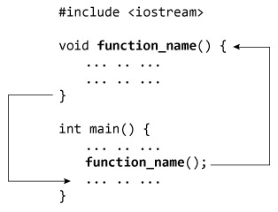

Slide 5

Function name
Parameters / arguments
int max(int num1, int num2) { // local variable declaration int result; if (num1 > num2) result = num1; else result = num2; return result; }
Return type (or void)
Function Body
Return value

Slide 6
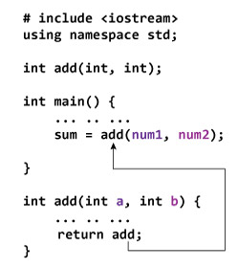
Declaration can be separate from the body

Slide 7
Why do we write functions?
Functions allow us to keep our variable namespace clean (local variables only "live" as long as the function does)
In other words, function_1 can use a variable called i, and function_2 can also use a variable called i and there is no confusion. Each variable i only exists when the computer is executing the given function
Functions allow us to test small parts of our program in isolation from the rest

Slide 8
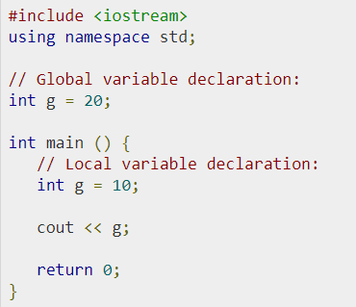
Variable scope
What is output?

Slide 9
Variable scope
10

Slide 10
Variable scope
int max(int num1, int num2) {
// local variable declaration int result; if (num1 > num2) result = num1; else result = num2; return result; }

Slide 11
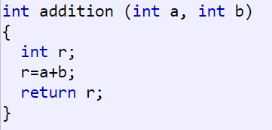


Slide 12
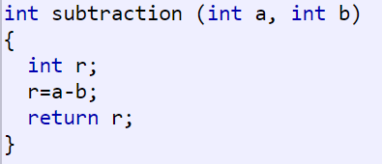
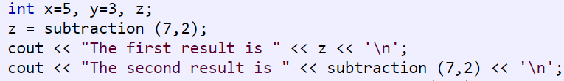

Slide 13
Scope of variables in c++
In general, scope is defined as the extent upto which something can be worked with
In programming also scope of a variable is defined as the extent of the program code within which the variable can we accessed or declared or worked with.
There are mainly two types of variable scopes:
Local ← all the time
Global ← almost never

Slide 14
Local variables
Variables defined within a function or block are said to be local to those functions.
Anything between ‘{‘ and ‘}’ is said to inside a block.
Local variables do not exist outside the block in which they are declared, i.e. they can not be accessed or used outside that block.
Declaring local variables: Local variables are declared inside a block.

Slide 15
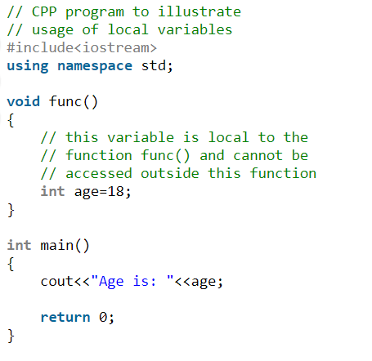
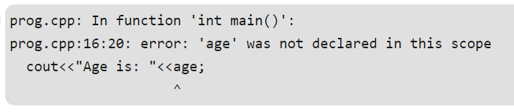

Slide 16
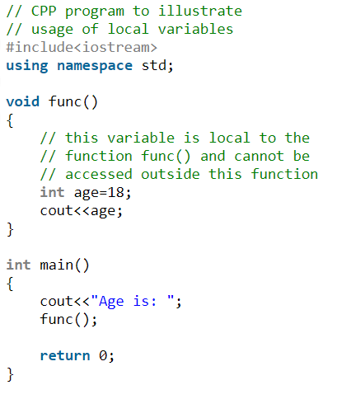

Slide 17
Global Variables
Global Variables can be accessed from any part of the program.
They are available through out the life time of a program.
They are declared at the top of the program outside all of the functions or blocks.
Declaring global variables: Global variables are usually declared outside of all of the functions and blocks, at the top of the program. They can be accessed from any portion of the program.

Slide 18
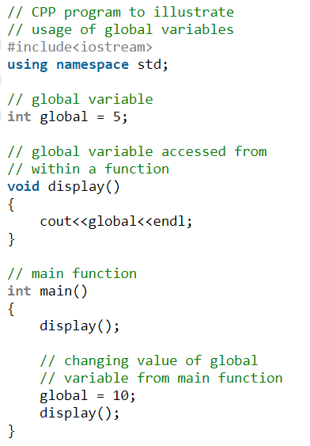

Slide 19
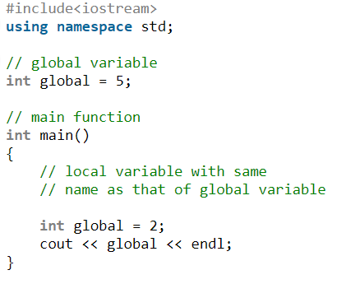

Slide 20
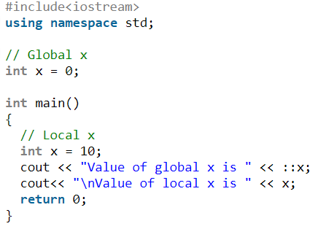
:: scope resolution operator

Slide 21
Function rules
Self documenting code
30 line rule
7 thing rule
Refactoring – extract function

Slide 22
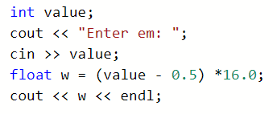


Slide 23
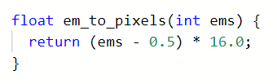


Slide 24
Todays Tasks
Rewrite C++ Tasks 1 using functions
For each task, create a new file
Function names:
The name should clearly, without ambiguity indicate what the function does.
https://repl.it/@JohnGlazebrook/c-console-colors-ASCII-code

Slide 25
